Slide 1


DEPARTMENT OF INFORMATION TECHNOLOGY
V R SIDDHARTHA ENGINEERING COLLEGE
Interpreting Doctors Prescription Using
Deep Learning Techniques
Domain : Health Care
B.Tech in INFORMATION TECHNOLOGY
EPICS Project Review Presentation
Presented by :
RIZWANULLAH MD ( 208W1A1299 )
AJAY KUMAR VARMA N ( 208W1A12A1 )
Under the guidance of
DR M SUNEETHA ( HOD IT )

Slide 2
Agenda :
01
Problem Statement
02
Objective’s Of Project
03
Literature Review
04
Datasets and Software Requirements
05
Architecture Diagram
06
Algorithm

Slide 3
Problem Statement
Interpreting Doctors Prescription ,notes using handwriting recognition and Deep Learning techniques
Solution to digitize the handwritten prescriptions which can also help to integrate tightly with other healthcare systems for seamless digitization and data flow.
Standardized forms can also be made machine readable with support for multiple local Indian languages to make digitization much simpler.

Slide 4
OBJECTIVE’S OF PROJECT
Helps people who cant understand doctor's prescription handwriting.
An ordinary individual can know name of the medicine prescribed in prescription.

Slide 5
LITERATURE REVIEW
This Research paper is taken from : https://www.researchgate.net/publication/353488043
Shaira Tabassum :- Has developed Medicine Name Recognition Model by using Bi-Directional Long short term memory (Bi directional LSTM)
Md Moshiur Rahman :- Graduate School of Biomedical and Health Sciences, MBBS, MPH, PhD. Has good knowledge about all medicines and their names and can recognize them on prescription. He helped sharia tabassum in terms of Medicine names and identification and some datasets he provided.

Slide 6
Ashir Ahmed :- He is an IT professional at Kyushu university.He is one team member worked with Shaira and he took some part in completing project.
They opted bangladeshi doctor’s handwritten prescription for their project and they achieved aprox 96% Accuracy on a bangla dataset by using BI directional LSTM and RSS model for Data Augmentation.

Slide 7
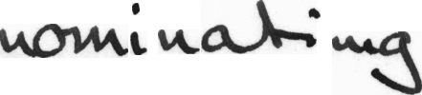



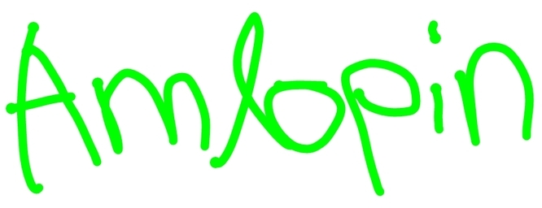
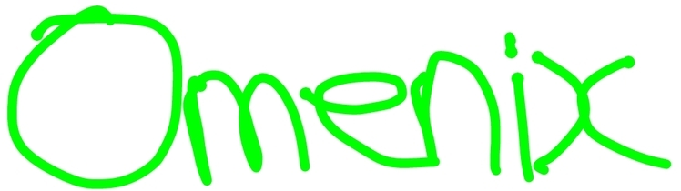
DATASET
Doctors hand writing dataset : https://github.com/rizwanrockzz/epics/tree/main/dataset

Slide 8
SOFTWARE REQUIREMENTS
User Requirements:
Dataset acquired from ieee.org
Input is an image with doctor prescription.
Output is digital text displayed on Screen.
Functional Requirements:
Python Programming Language.
Bi directional LSTM model.
Tensorflow,keras Py Libraries.
System Requirements:
Windows Operating System.
Configuration: RAM 8GB.
Software : VS Code.
Non-Functional Requirements:
Accuracy.
Reliability.

Slide 9
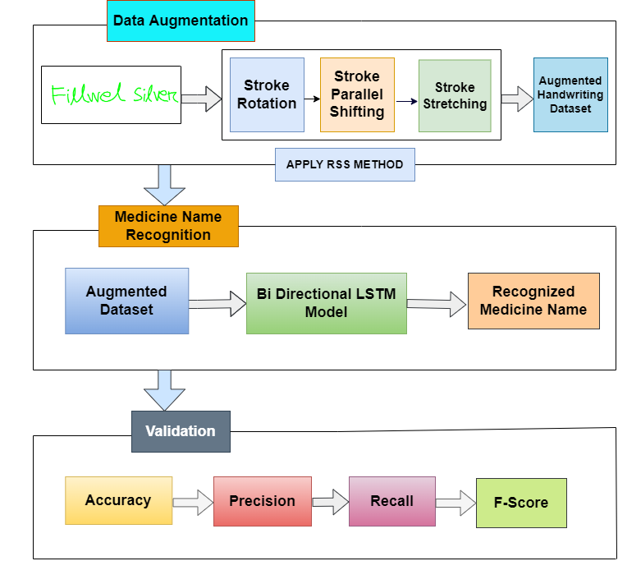
ARCHITECTURE
diagram

Slide 10
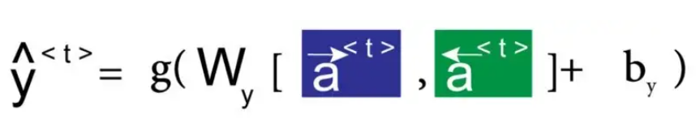
ALGORITHM For Bi-Directional LSTM
Mathematical Equation For Bi-Directional LSTM Model is Below:
Here we apply forward propagation 2 times , one for the forward cells and one for the backward cells
Both activations(forward , backward) would be considered to calculate the output y^ at time t

Slide 11
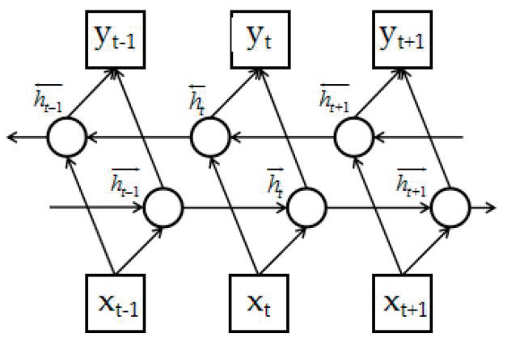
How cells are connected forward and backward in Bi-Directional LSTM Model
Structure of Bi-Directional LSTM Networks

Slide 12
Implementation Steps:
Data collection: Importing Dataset from git repository (IAM dataset)
Importing all required Deep learning related python libraries like Tensorflow Keras, Matplotlib, Numpy.
Read the metadata txt file and store the words with “ok” into new array. And then splitting the dataset into 3 parts i.e Training, Validation, testing samples with ration 90:5:5
Find maximum length and the size of the vocabulary in the training data. Then build character vocabulary.
Resizing the images without distortion in a rectangular size.

Slide 13
Set image width to 128,height to 32,Batch size to 64 and padding token to 99.
Code for pre processing image, Vectorizing image labels, process image labels and for prepare dataset.
Build model with 2 Convolution layers, 2 Max Pooling layers, Add Reshape, Dense and dropout layer, Add 2 Bi directional LSTM layers with filter value as 128, 64 and dropout to 0.25.
Now, Add 2nd Dense layer with “Softmax” activation. And finally add ctc layer for calculating ctc loss at each step
Set Optimizer to “adam” and then build the model.
Now add Evaluation metrics, validation images and validation labels. And then create a callback to monitor the edit distances.
Now, Build model and then set epoch value and fit model.And train the model.
Now take images from testing set and pass them to input layer and predict them. Then, we can get output of predicted text by model.
Now plot a graph for Value loss function loss vs var_loss.

Slide 14
Conclusion:-
Finally, this application interface will make it simple for
people to access the model and interact with it through the
application. Furthermore, this technique allows the majority of
users to verify the notes or prescriptions without any prior
knowledge in calligraphy analysis. Therefore, this technology
will eliminate human mistakes and pave the way for customers
to assess it without the assistance of experts.

Slide 15
Thank You

